Slide 1

Learning continuously without forgetting for Continual Semantic Segmentation
CVPR 2021
Arthur Douillard Yifu Chen Arnaud Dapogny Matthieu Cord

Slide 2

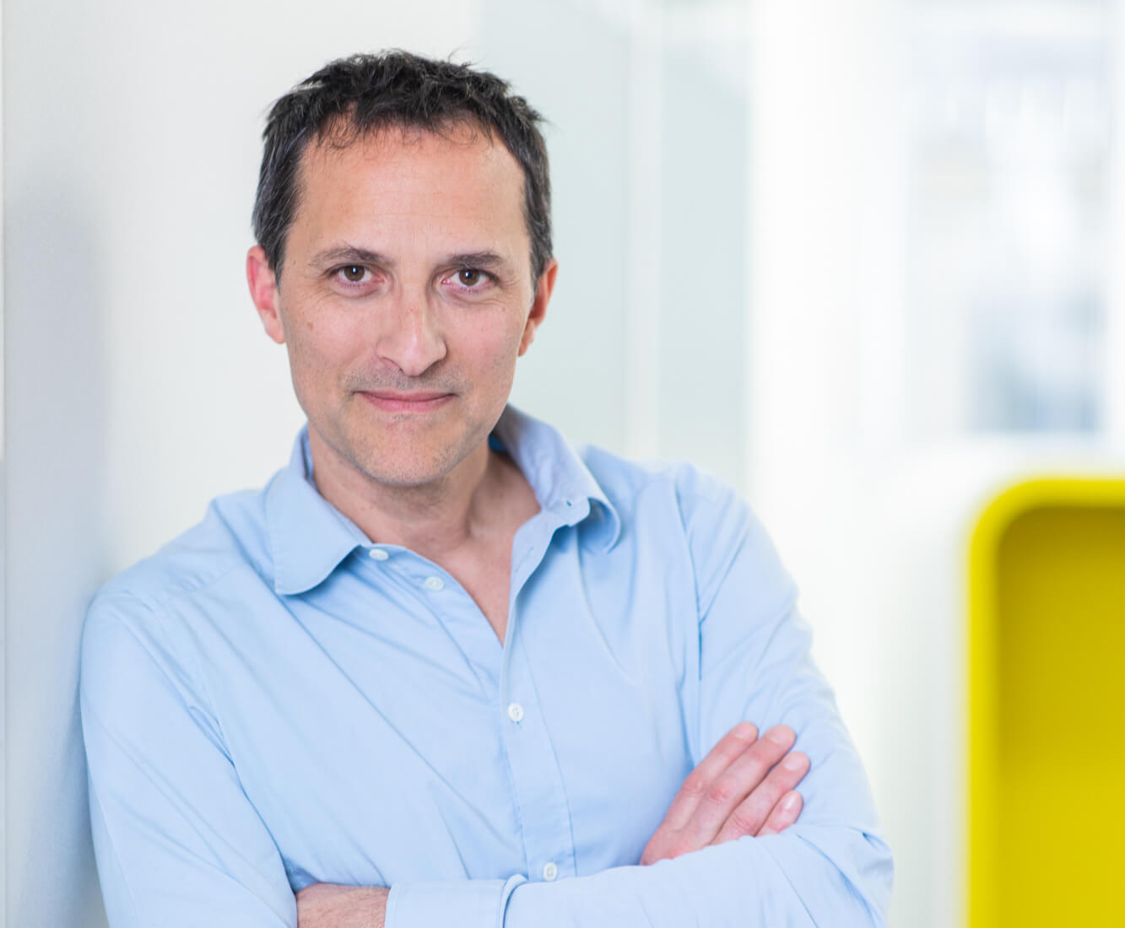
The Team
Continual Segmentation
The Team
Arthur Douillard
Sorbonne Université
Heuritech
Yifu Chen
Sorbonne Université
Arnaud Dapogny
Datakalab
Matthieu Cord
Sorbonne Université
Valeo.ai
Notes:
Thanks you for listenning

Slide 3
What is Continual Learning?

Slide 4
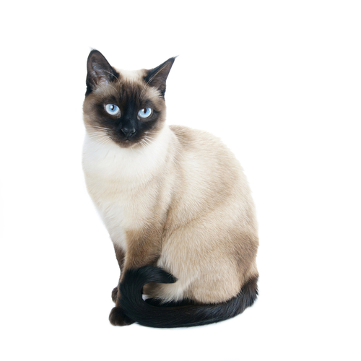

What
What
Data independent and identically distributed (iid) assumption
Evaluate on a fixed test set
Train once
f
…

Slide 5
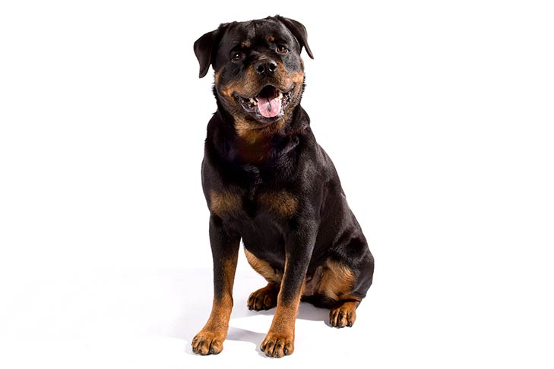

What
What
Data independent and identically distributed (iid) assumption
Evaluate on a fixed test set
Retrain from scratch
f
…

Slide 6
What
What
Retraining everytime is not always possible:
Slow → companies with ever-growing datasets
Privacy → data is only available for a short time
Memory limitation → poor robot in the wild doesn’t have peta of disk storage

Slide 7
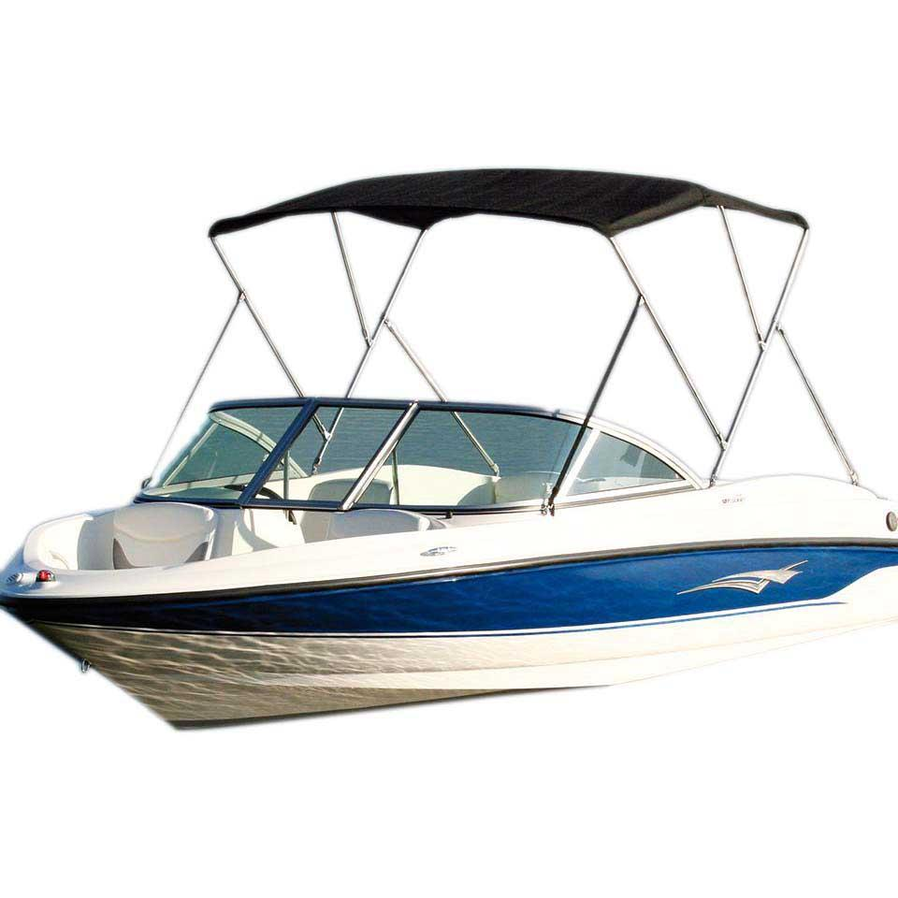
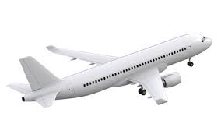
What
What
Real world data is rarely independent and identically distributed (i.i.d.)
New classes [1] may appear:
…
[1]: Lomonaco and Maltoni, CORe50: a New Dataset and Benchmark for Continuous Object Recognition, 2017

Slide 8

Protocol
What
Protocol
Initialize model $f^{0}$
Train $f^{0}$on $t=0$

Slide 9

Protocol
What
Protocol
Initialize model $f^{0}$
Train $f^{0}$on $t=0$
For $t =1$; $t < T$; $t++$
Initialize model: $f^{t}←f^{t−1}$

Slide 10

Protocol
What
Protocol
Initialize model $f^{0}$
Train $f^{0}$on $t=0$
For $t =1$; $t < T$; $t++$
Initialize model: $f^{t}←f^{t−1}$
Add classifier weights to $f^{t}$

Slide 11

Protocol
What
Protocol
Initialize model $f^{0}$
Train $f^{0}$on $t=0$
For $t =1$; $t < T$; $t++$
Initialize model: $f^{t}←f^{t−1}$
Add classifier weights to $f^{t}$
Train $f^{t}$ on $t$

Slide 12

Protocol
What
Protocol
Initialize model $f^{0}$
Train $f^{0}$on $t=0$
For $t =1$; $t < T$; $t++$
Initialize model: $f^{t}←f^{t−1}$
Add classifier weights to $f^{t}$
Train $f^{t}$ on $t$
Evaluate $f^{t}$ on $\left\{1, …, t\right\}$

Slide 13
Evaluation
What
Single-head vs Multi-heads during evaluation [14]?
Task 1
Task 2
[14]: Chaudhry et al., Riemannian Walk for Incremental Learning: Understanding Forgetting and Intransigence, 2018

Slide 14
Evaluation
What
Single-head vs Multi-heads during evaluation [14]?
Task 1
Final Evaluation:
Task 2
[14]: Chaudhry et al., Riemannian Walk for Incremental Learning: Understanding Forgetting and Intransigence, 2018

Slide 15
Evaluation
What
Single-head vs Multi-heads during evaluation [14]?
Task 1
Single
{dog, cat, boat, plane} ?
Final Evaluation:
Task 2
Multi
{dog, cat} ?
[14]: Chaudhry et al., Riemannian Walk for Incremental Learning: Understanding Forgetting and Intransigence, 2018

Slide 16
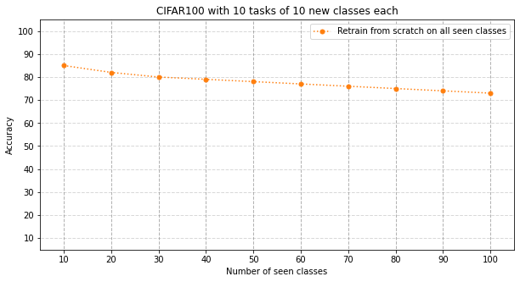
Example
What

Slide 17
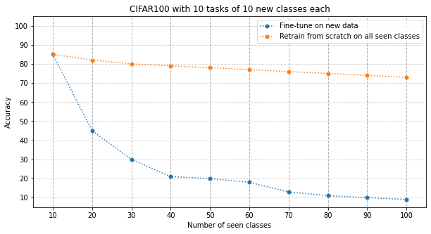
Example
What

Slide 18
Example
What
Final accuracy: 9%

Slide 19
Example
What
Average of all tasks: 26%

Slide 20
Example
What
Catastrophic Forgetting

Slide 21
How to Solve it?

Slide 22
Broad Strategies
How
Rehearsal
Constraints
Architecture
Classifier Correction

Slide 23
Broad Strategies
How
Rehearsal
Constraints
Architecture
Classifier Correction

Slide 24





1. Rehearsal
How
Replay a limited amount of previous data
e.g. iCaRL [3]
Training task 1
Training task 2
Training task 3
Model
f ⁰
f ¹
f ²
f ³
Train
Train
Train
Initial classes
Memory
m¹
⋮
m¹⁰
m¹
⋮
m²⁰
m¹
⋮
m⁷⁰
C ¹
⋮
C ¹⁰
New classes
C ¹¹
⋮
C ²⁰
C ²¹
⋮
C ³⁰
C ⁷¹
⋮
C ⁸⁰
[3]: Rebuffi et al., iCaRL: Incremental Classifier and Representation Learning, 2017

Slide 25



1. Rehearsal
How
Generate a limited amount of previous data
e.g. DGR [15]
Training task 1
Training task 2
Training task 3
Model
f ⁰
f ¹
f ²
f ³
Train
Train
Train
Generator
g ⁰
g ¹
g ²
g ¹
C ⁰
⋮
C ⁵⁰
C ⁰
⋮
C ⁶⁰
C ⁰
⋮
C ⁷⁰
Initial classes
Generated old classes
C ¹
⋮
C ⁵⁰
New classes
C ⁵¹
⋮
C ⁶⁰
C ⁶¹
⋮
C ⁷⁰
C ⁷¹
⋮
C ⁸⁰
[15]: Shin et al., Continual Learning with Deep Generative Replay, 2017

Slide 26
Broad Strategies
How
Rehearsal
Constraints
Architecture
Classifier Correction

Slide 27



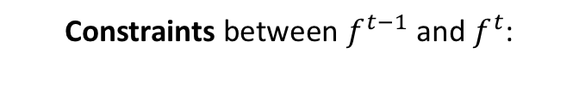
2. Constraints
How
Constraints between $f^{t−1}$ and $f^{t}$:
Training task 1
Training task 2
Training task 3
f ⁰
Train
f ¹
Train
f ²
Train
f ³

Slide 28
2. Constraints
How
Constraints between $f^{t−1}$ and $f^{t}$:
Training task 1
Training task 2
Training task 3
f ⁰
Train
f ¹
Train
f ²
Train
f ³
Constraint
Constraint
Constraint

Slide 29
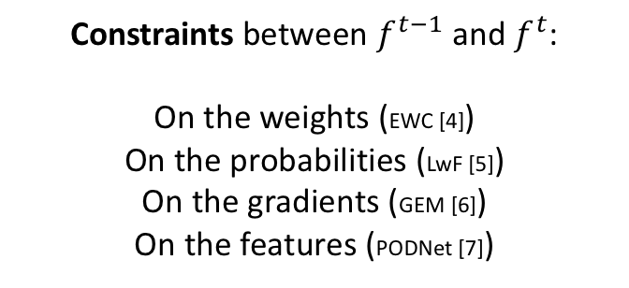
2. Constraints
How
Constraints between $f^{t−1}$ and $f^{t}$:
On the weights (EWC [4]) On the probabilities (LwF [5])
On the gradients (GEM [6])
On the features (PODNet [7])
Training task 1
Training task 2
Training task 3
f ⁰
Train
f ¹
Train
f ²
Train
f ³
Constraint
Constraint
Constraint
[4]: Kirkpatrick et al., Overcoming catastrophic forgetting in neural networks, 2017
[5]: Li and Hoiem, Learning without forgetting, 2016
[6]: Lopez-Paz and Ranzato, Gradient episodic memory for continual learning, 2017
[7]: Douillard et al., PODNet: Pooled Outputs Distillation for small-tasks incremental learning, 2020

Slide 30
Broad Strategies
How
Rehearsal
Constraints
Architecture
Classifier Correction

Slide 31
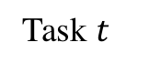
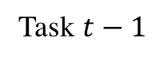
3. Architecture
How
One sub-network per task
Task $t−1$
Task $t$
Often requires in inference the task id to select the task-specific sub-network.
Sub-network can be uncovered via evolutionary algorithms (PathNet [8]), sparsity (Neural Pruning [9]), or learned masks (CPG [10]).
Neurons can also be added (MNTDP-D [16])
Two sub-networks & can co-exist
in the same network
[8]: Fernando et al., PathNet: Evolution Channels Gradient Descent in Super Neural Networks , 2017
[9]: Golkar et al., Continual learning via neural pruning, 2019
[10]: Hung et al., Compacting, picking and growing for unforgetting continual learning, 2019 [16] Veniat et al., Efficient Continual Learning with Modular Networks and Task-Drive Priors, 2021

Slide 32
Broad Strategies
How
Rehearsal
Constraints
Architecture
Classifier Correction

Slide 33
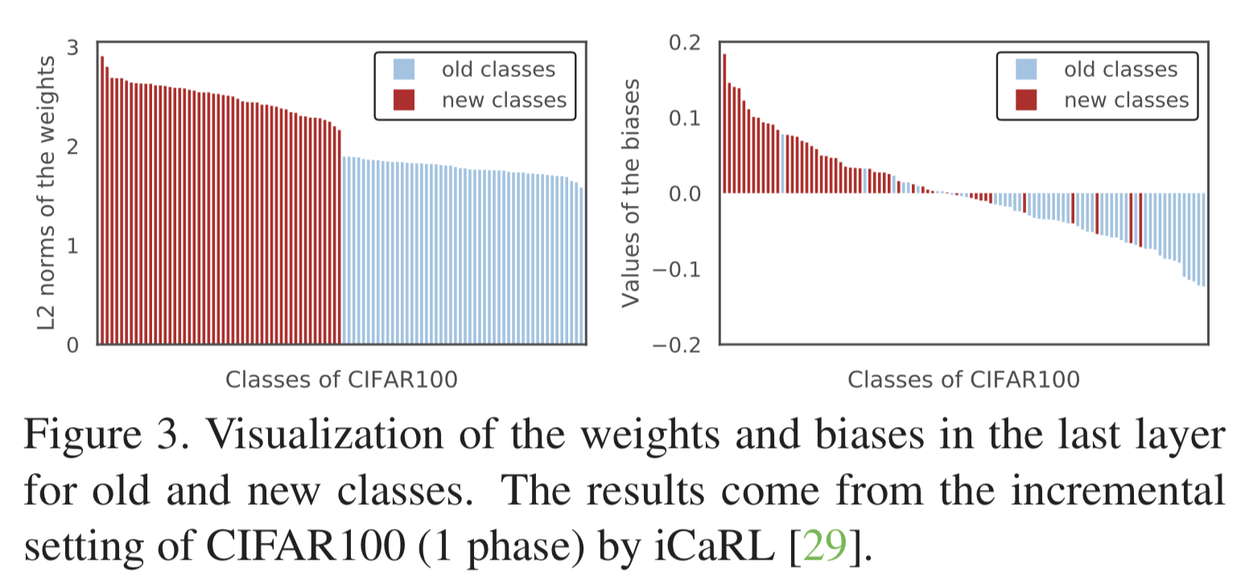
4. Classifier Correction
How
Classifier is biased towards new classes

Slide 34
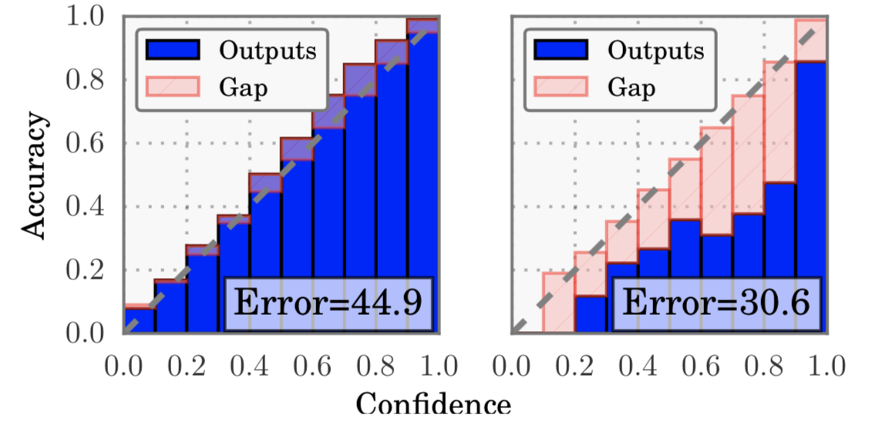
4. Classifier Correction
How
Classifier is biased towards new classes
Can be recalibrated (BiC [11] )
Calibrated Model
Miscalibrated Model
[11]: Wu et al., Large scale incremental learning, 2019

Slide 35
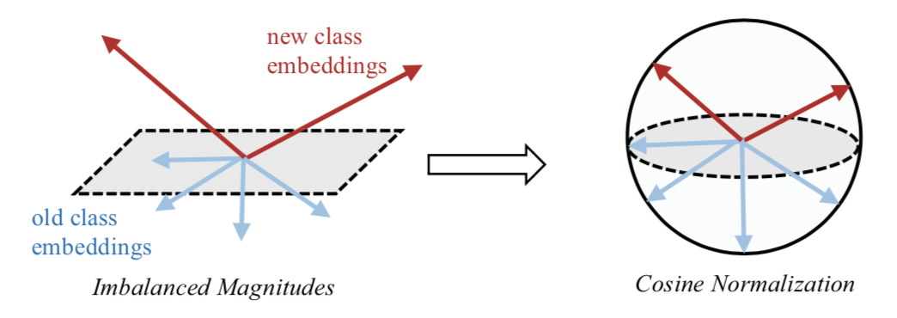
4. Classifier Correction
How
Classifier is biased towards new classes
Or normalized (LUCIR [12])
[11]: Wu et al., Large scale incremental learning, 2019
[12]: Hou et al., Learning an unified classifier incrementally via rebalancing, 2019

Slide 36
Learning without Forgetting for Continual Semantic Segmentation

Slide 37
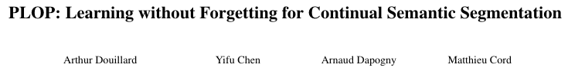
PLOP, CVPR 2021
Continual Segmentation
Constraints + Pseudo-labeling

Slide 38
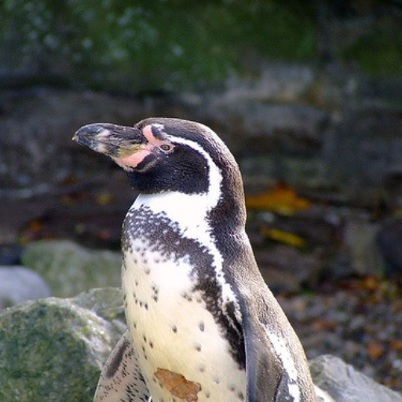
Segmentation
Continual Segmentation
Semantic Segmentation → each pixel is labeled

Slide 39
Continual?
Continual Segmentation
Semantic Segmentation → each pixel is labeled
Continual Semantic Segmentation?

Slide 40
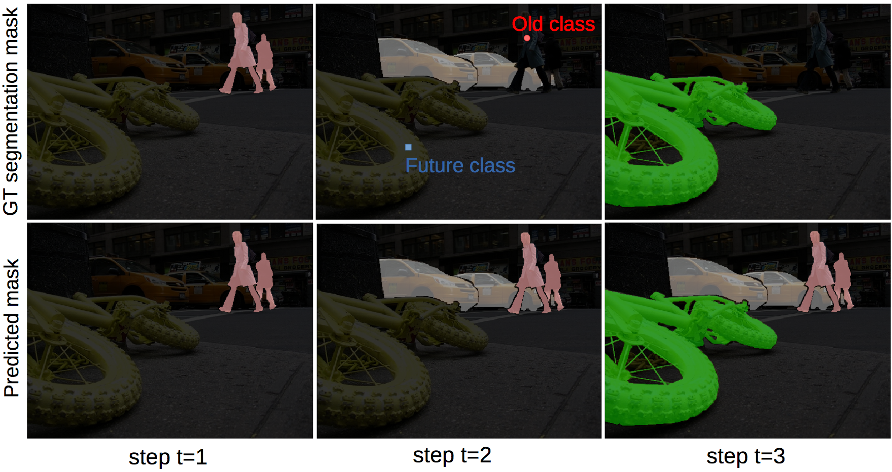
Background shift
Continual Segmentation
[13]: Cermelli et al., Modeling the Background for Incremental in Semantic Segmentation, 2020

Slide 41
Background shift
Continual Segmentation
[13]: Cermelli et al., Modeling the Background for Incremental in Semantic Segmentation, 2020

Slide 42
Background shift
Continual Segmentation
[13]: Cermelli et al., Modeling the Background for Incremental in Semantic Segmentation, 2020

Slide 43
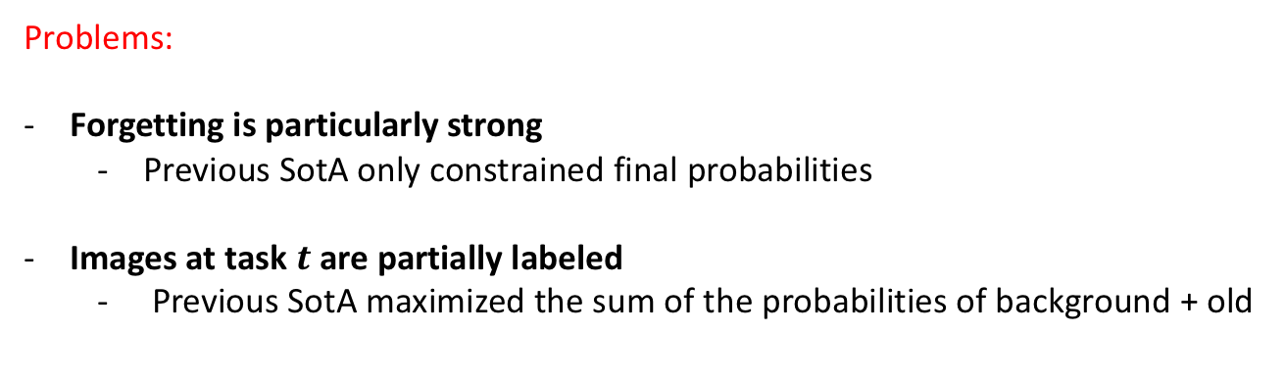
Problems and weakness
Continual Segmentation
Problems:
Forgetting is particularly strong
Previous SotA only constrained final probabilities
Images at task $t$ are partially labeled
Previous SotA maximized the sum of the probabilities of background + old

Slide 44
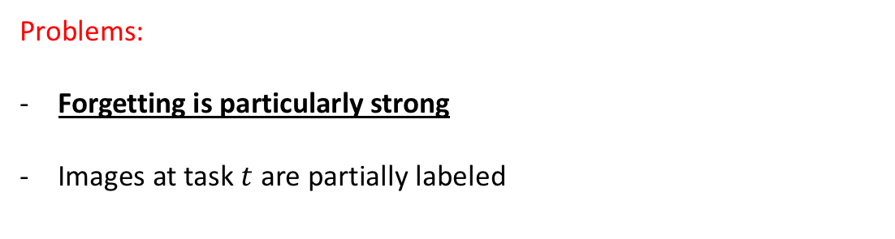
Problem 1: Forgetting
Continual Segmentation
Problems:
Forgetting is particularly strong
Images at task $t$ are partially labeled

Slide 45
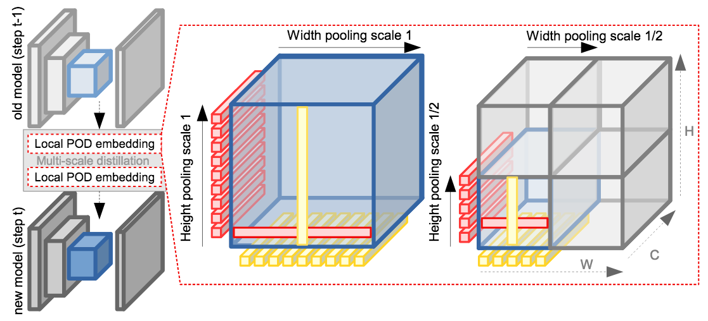
Problem 1: Forgetting
Continual Segmentation
POD?

Slide 46
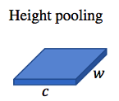
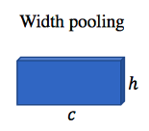
Problem 1: Forgetting
Continual Segmentation
Multi-stage features-based distillation loss (POD)
f ^{t-1}
f ^{t-1}
L2
L2

Slide 47
Problem 1: Forgetting
Continual Segmentation
POD?

Slide 48
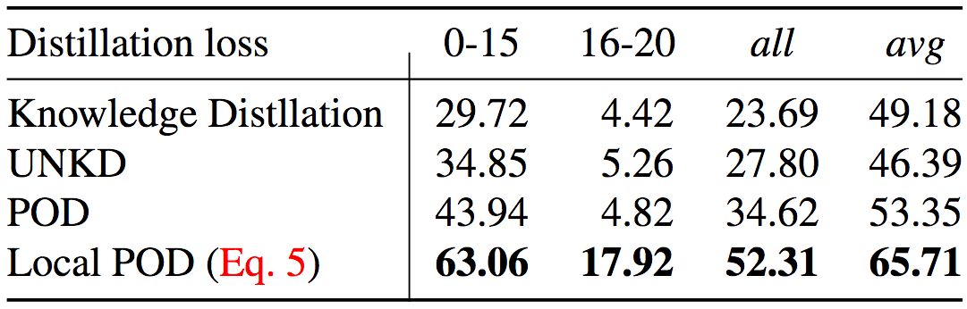
Problem 1: Forgetting
Continual Segmentation
POD?

Slide 49
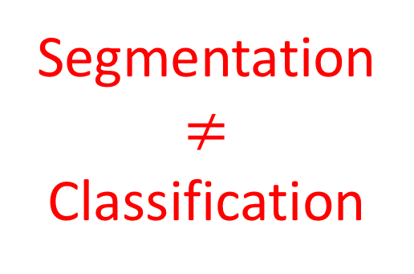
Problem 1: Forgetting
Continual Segmentation
POD?
Segmentation
$≠$
Classification

Slide 50
Problem 1: Forgetting
Continual Segmentation
Local POD!

Slide 51
Problem 1: Forgetting
Continual Segmentation
Local POD for the win!

Slide 52
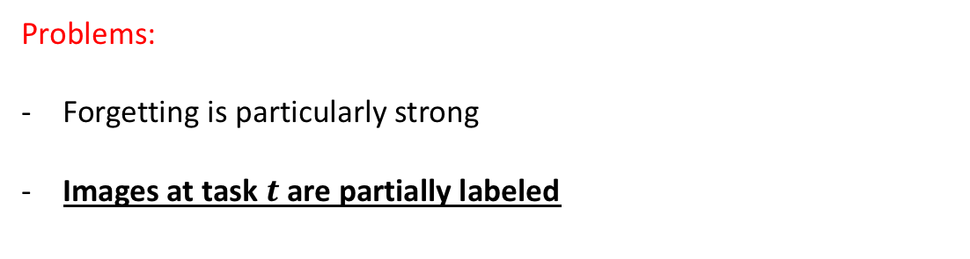
Problem 1: Background shift
Continual Segmentation
Problems:
Forgetting is particularly strong
Images at task $t$ are partially labeled

Slide 53
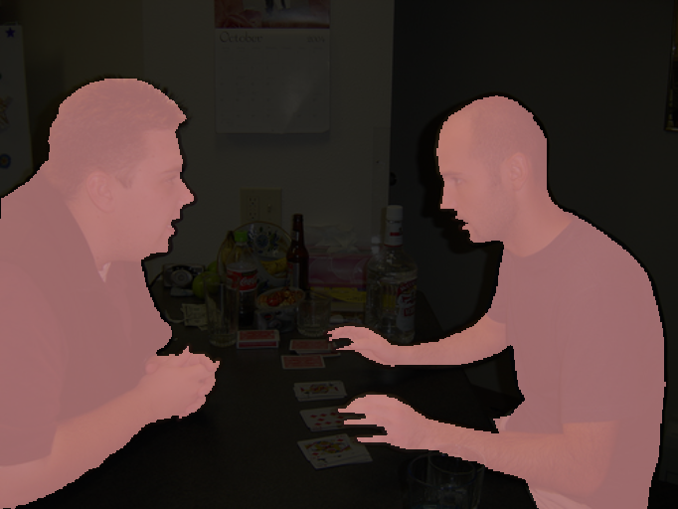
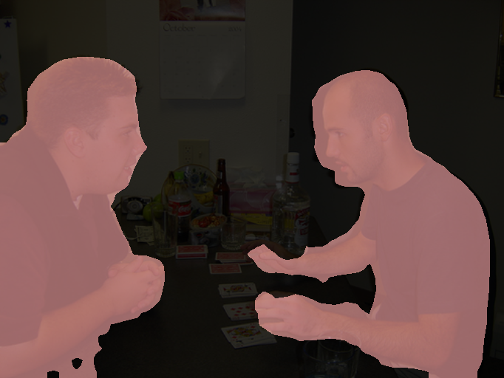
Problem 1: Background shift
Continual Segmentation
Step 1
person
GT
Current Predictions

Slide 54
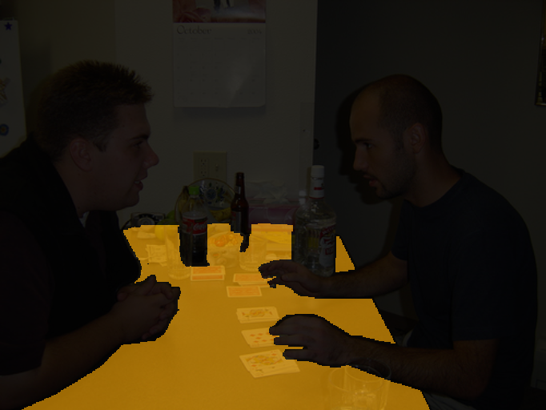
Problem 1: Background shift
Continual Segmentation
Step 1
Step 2
person
GT
table
Current Predictions

Slide 55
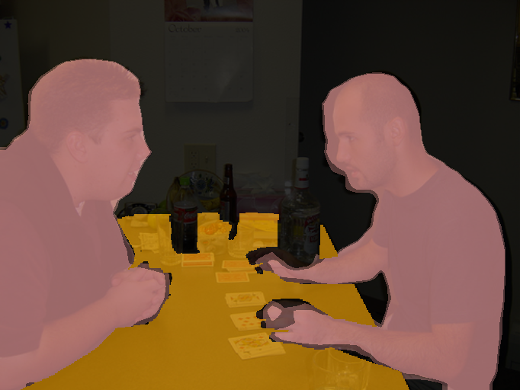
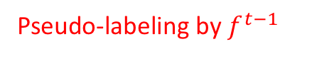
Problem 1: Background shift
Continual Segmentation
Step 1
Step 2
person
GT
table
Pseudo-labeling by $f^{t−1}$
GT + Pseudo-labels = Target
Current Predictions

Slide 56
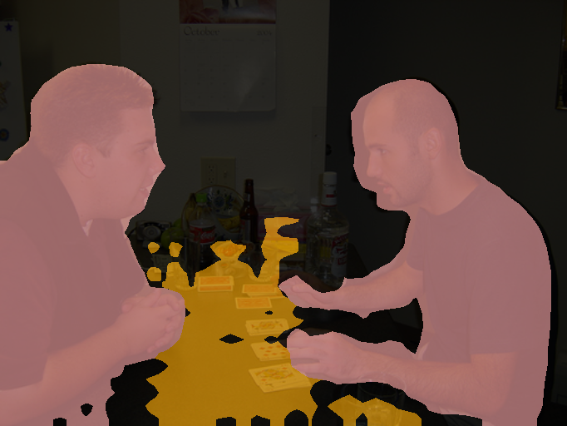
Problem 1: Background shift
Continual Segmentation
Step 1
Step 2
person
GT
table
GT + Pseudo-labels = Target
Current Predictions

Slide 57
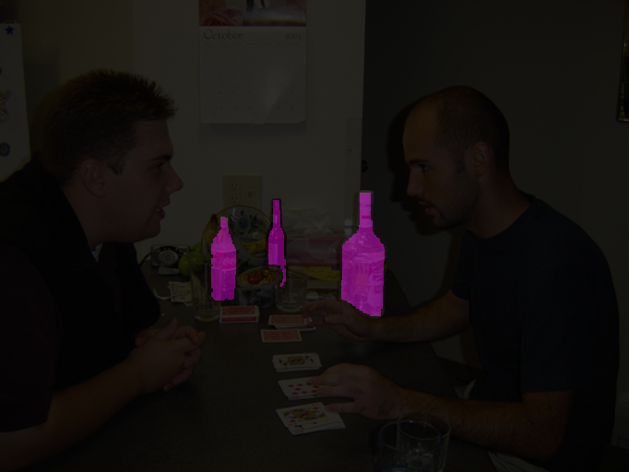
Problem 1: Background shift
Continual Segmentation
Step 1
Step 2
Step 3
person
GT
table
bottle
GT + Pseudo-labels = Target
Current Predictions

Slide 58
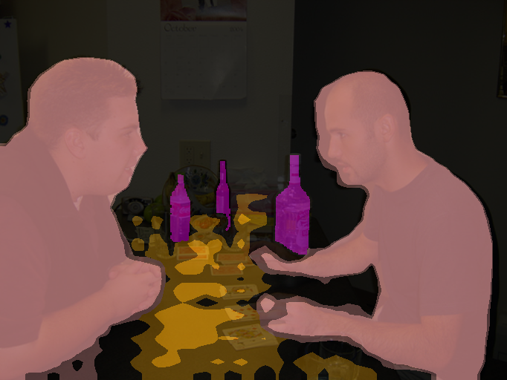
Problem 1: Background shift
Continual Segmentation
Step 1
Step 2
Step 3
person
GT
table
bottle
GT + Pseudo-labels = Target
Current Predictions

Slide 59
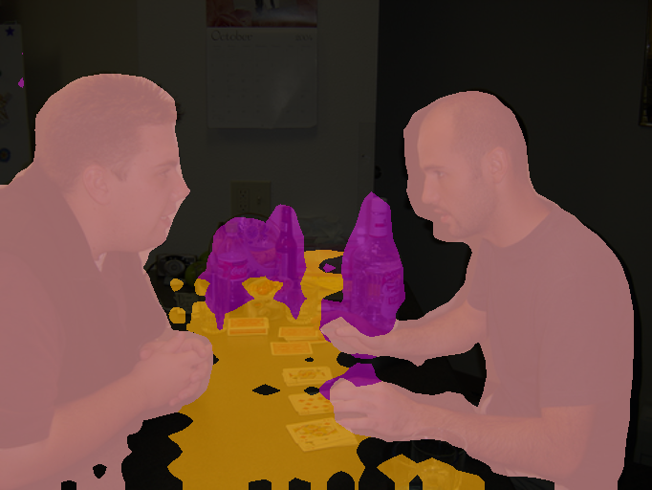
Problem 1: Background shift
Continual Segmentation
Step 1
Step 2
Step 3
person
GT
table
bottle
GT + Pseudo-labels = Target
Current Predictions

Slide 60
Problem 1: Background shift
Continual Segmentation
Step 1
Step 2
Step 3
person
GT
table
bottle
Uncertain pixels are discarded
GT + Pseudo-labels = Target
Current Predictions

Slide 61
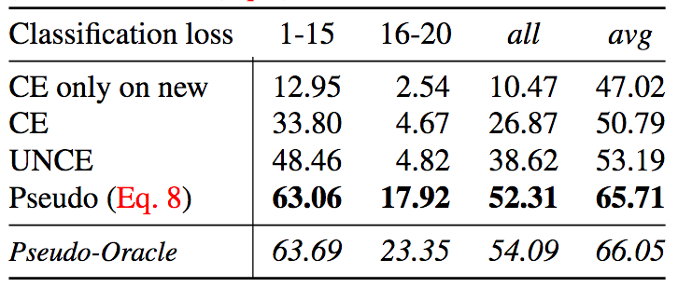
Problem 1: Background shift
Continual Segmentation
UNCE (CVPR 2020) merges predictions of old classes with background

Slide 62
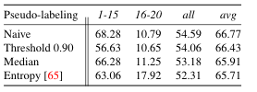
Different pseudo-labeling
Continual Segmentation
Pseudo-labelize all pixels that are ”background”

Slide 63
Different pseudo-labeling
Continual Segmentation
Pseudo-labelize all pixels that are ”background”
And confident enough

Slide 64
Different pseudo-labeling
Continual Segmentation
Pseudo-labelize all pixels that are ”background”
And entropy low enough
And adaptive sample weight

Slide 65
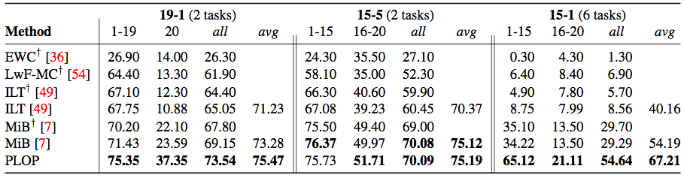
Experiments
Continual Segmentation
Pascal-VOC (20 classes) experiments

Slide 66
Experiments
Continual Segmentation
Pascal-VOC (20 classes) experiments

Slide 67
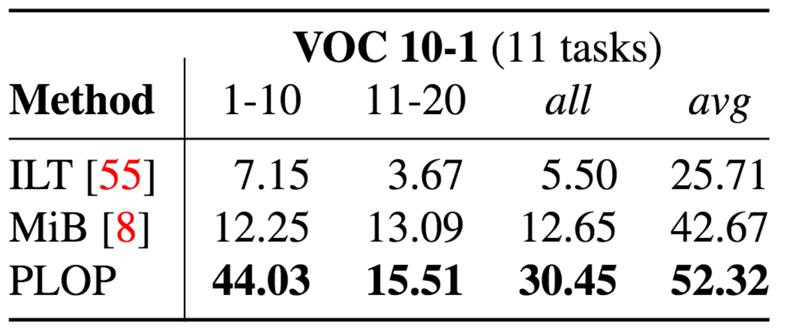
Experiments
Continual Segmentation
Pascal-VOC (20 classes) experiments

Slide 68
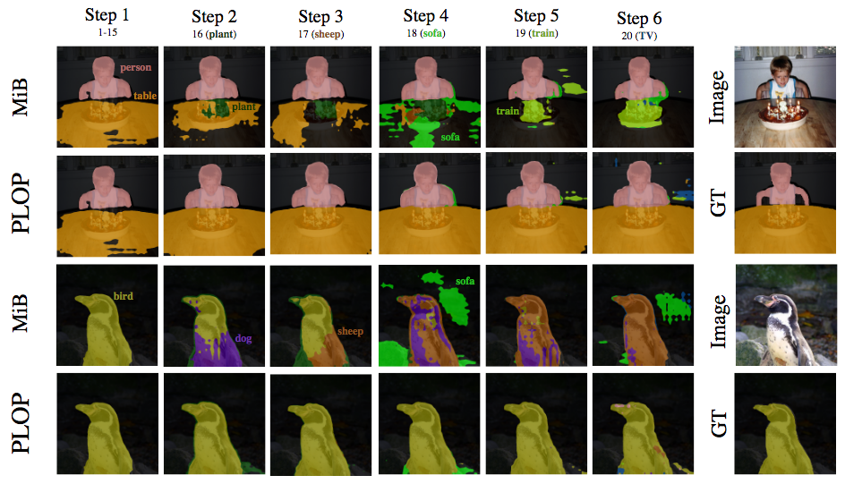
Visuals
Continual Segmentation
First, learn 15 classes

Slide 69
Visuals
Continual Segmentation
Learn the “plant” class

Slide 70
Visuals
Continual Segmentation
So far, it’s still OK

Slide 71
Visuals
Continual Segmentation
Catastrophic forgetting

Slide 72
Visuals
Continual Segmentation

Slide 73
Visuals
Continual Segmentation

Slide 74
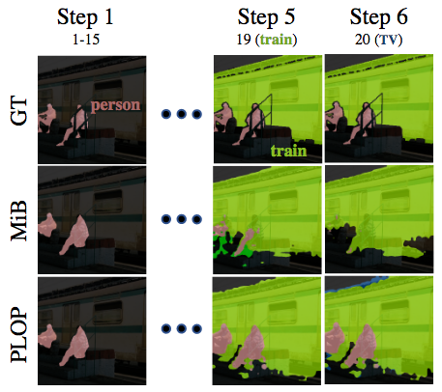
Visuals
Continual Segmentation
When a class appear only latter in the image

Slide 75
Soon to be released…

Slide 76
Failure Case of Pseudo-Labeling
Continual Segmentation
How to pseudo-labels, when there is nothing to pseudo-labels?

Slide 77
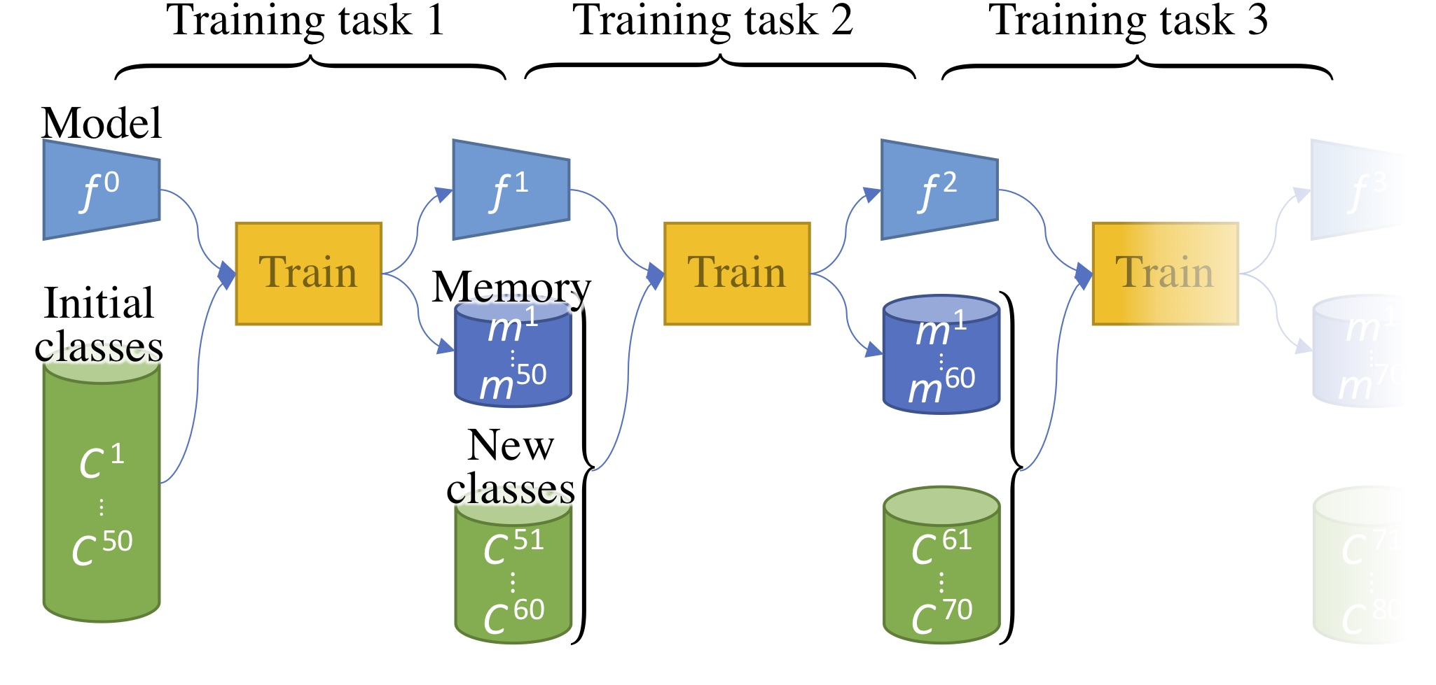
Rehearsal Learning
Continual Segmentation

Slide 78
Rehearsal Learning
Continual Segmentation
Need to pseudo-labels memory samples!

Slide 79
Rehearsal Learning
Continual Segmentation
Need to pseudo-labels memory samples!

Slide 80
Rehearsal Learning
Continual Segmentation
Very large segmentation images are heavy to store!
Segmentation images are mostly useless
63% pixels of Pascal-VOC is background
32% pixels of Cityscapes are roads

Slide 81
Rehearsal Learning
Continual Segmentation
Can we store only what matter?

Slide 82
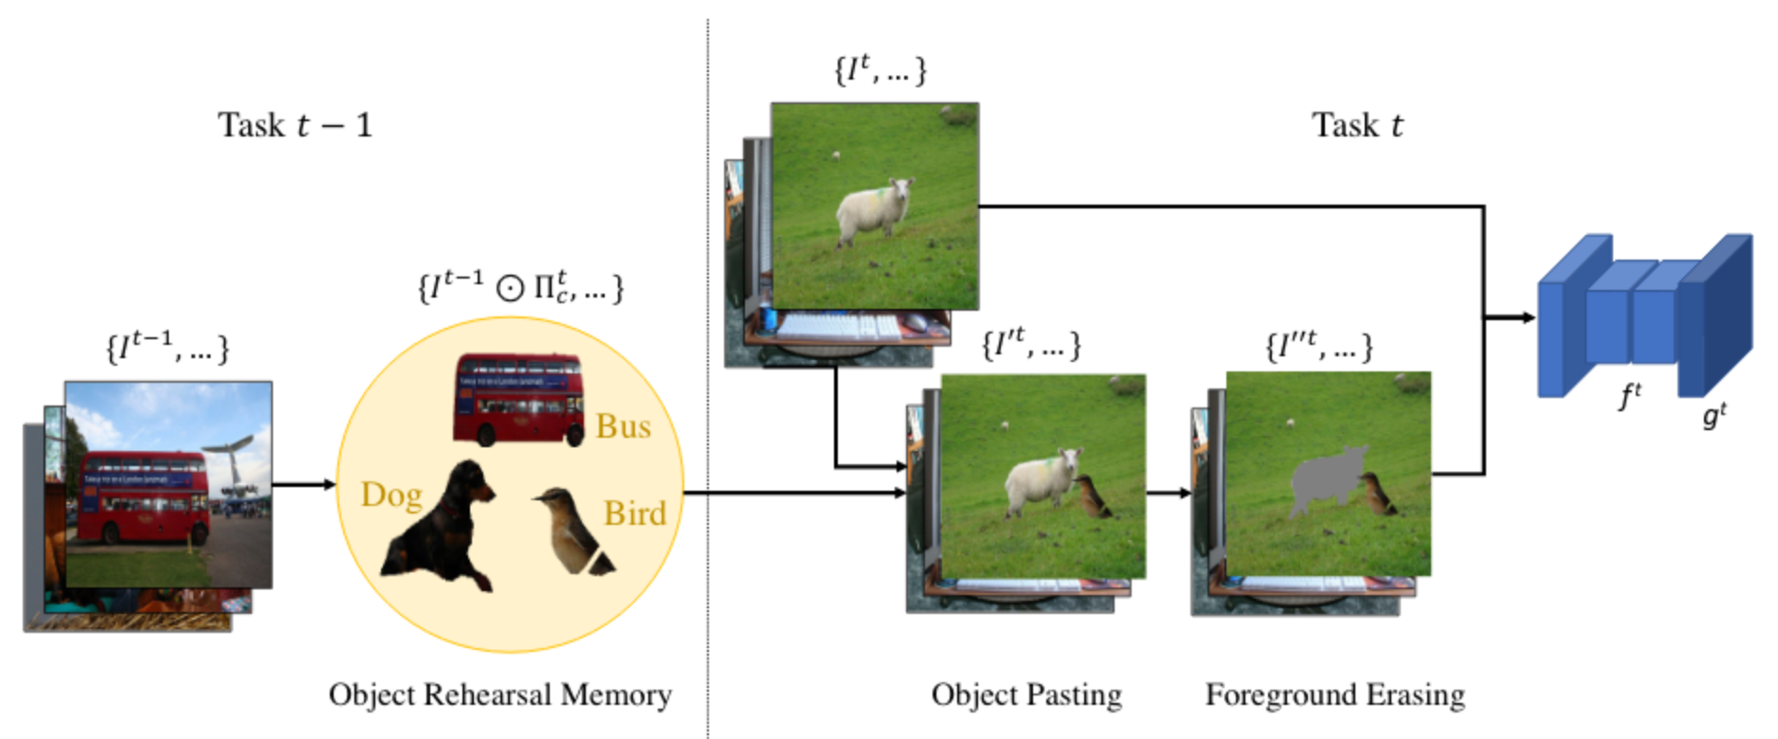
Object Learning
Continual Segmentation
Storing only the objects

Slide 83
Object Learning
Continual Segmentation
Pasting into current task images

Slide 84
Object Learning
Continual Segmentation
Interference!

Slide 85
Object Learning
Continual Segmentation
Selecting erasing!

Slide 86
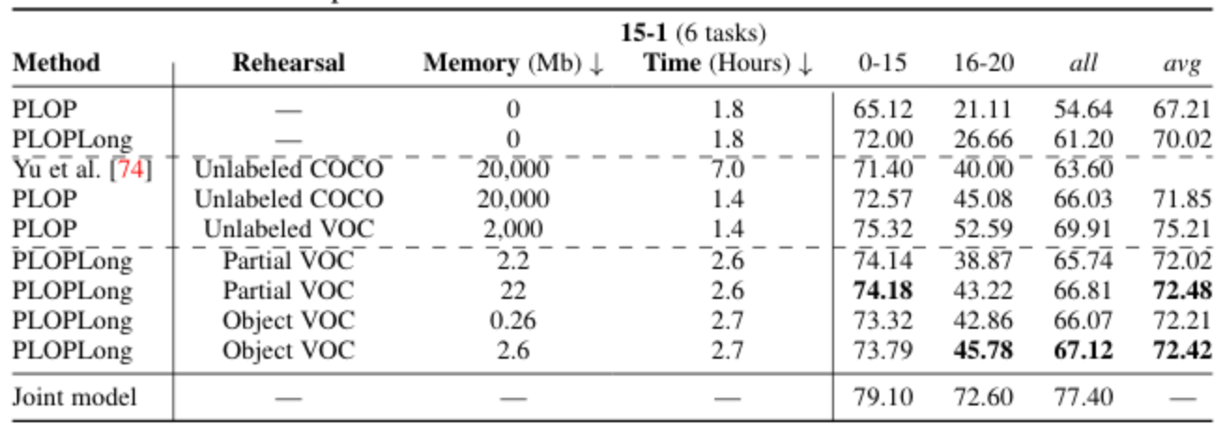
Object Learning
Continual Segmentation

Slide 87
Object Learning
Continual Segmentation

Slide 88
Object Learning
Continual Segmentation

Slide 89
Object Learning
Continual Segmentation

Slide 90
Object Learning
Continual Segmentation

Slide 91
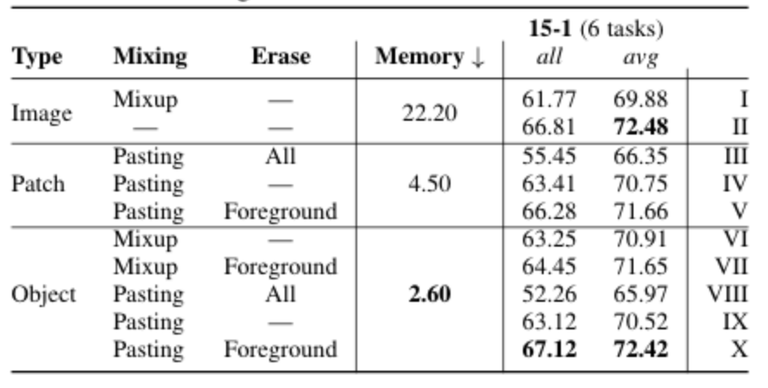
Object Learning
Continual Segmentation

Slide 92
What are your questions?

